Slide 1

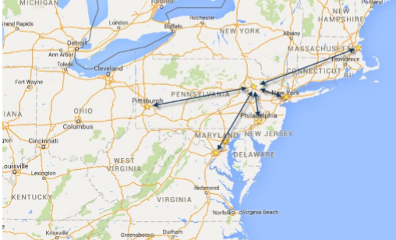

September 24-27, 2024 | Pocono Manor, PA
Great speakers with top content
A fraction of the cost of the more crowded conferences
- 3-day conference plus lodging for ~$1000
Full-day deep dive preconference sessions available
Easy travel from almost anywhere
World-class keynotes
In addition to the sessions, you get a great hallway
Track, amazing food, attendee Welcome Reception, Game Night & more
Family Day Friday - full day of kids' sessions, free for attendees' families
Discounted Kalahari Resort rooms with water park access: stay, learn & play all week
https://techbash.com or @techbash

